Slide 1
Capstone Project Sollution
By Prashant

Slide 2
Question 1: Explore the Data using Excel . understand the data and prepare a short summary about the dataset.

Slide 3
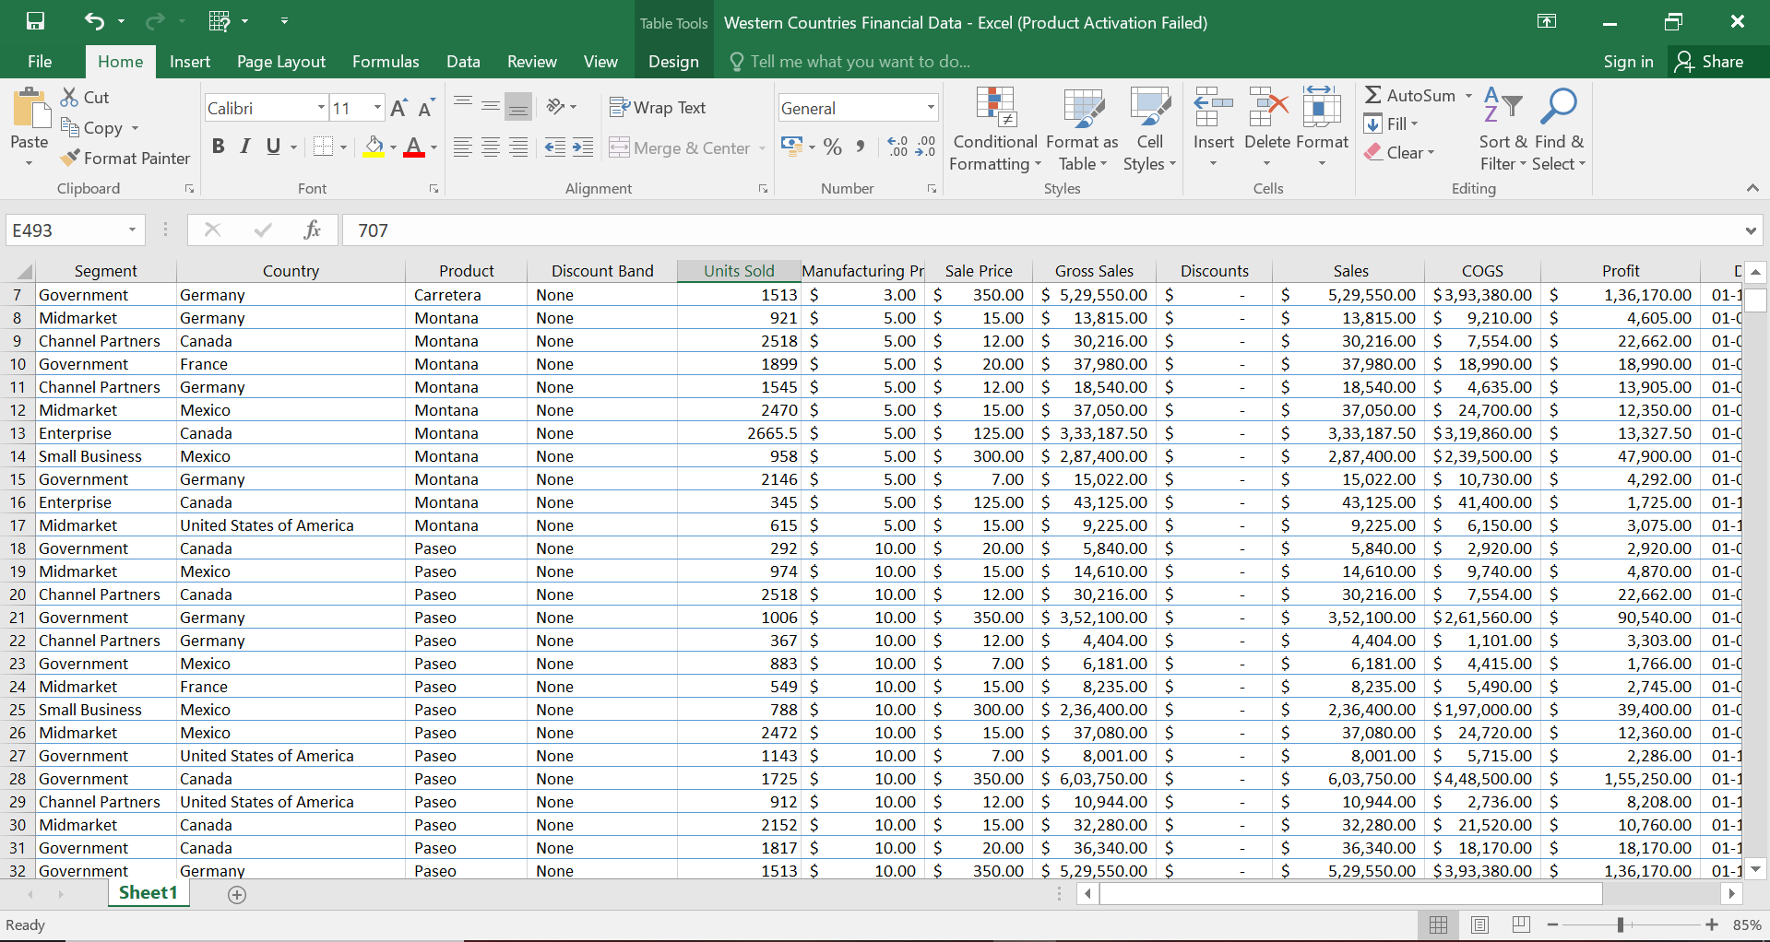

Slide 4
When we explore financial data of western country then we know__
Country
Product
Selling Price
Unit Sold
Manufacturing
Sell Price
Gross Price
Segment

Slide 5
We have a purchacing data of Canada, Germany, France,Maxico And USA. In the given data show the sells, gross sells, cogs and sells. We have

Slide 6
Question 2:Perform Data cleaning if required and then do Statistical Analysis on data using statistical tools

Slide 7
Data cleaning: We delete some rows for a special analysis for sell and profit. We want only two major columns like segment, country, sells and profit.

Slide 8
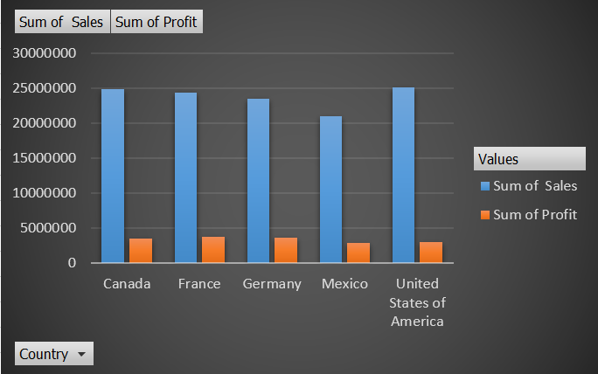
For analysis on sells and profit

Slide 9
Question 3: Perform Graphical Analysis on the Data using Excel and Derive insights from it.

Slide 11
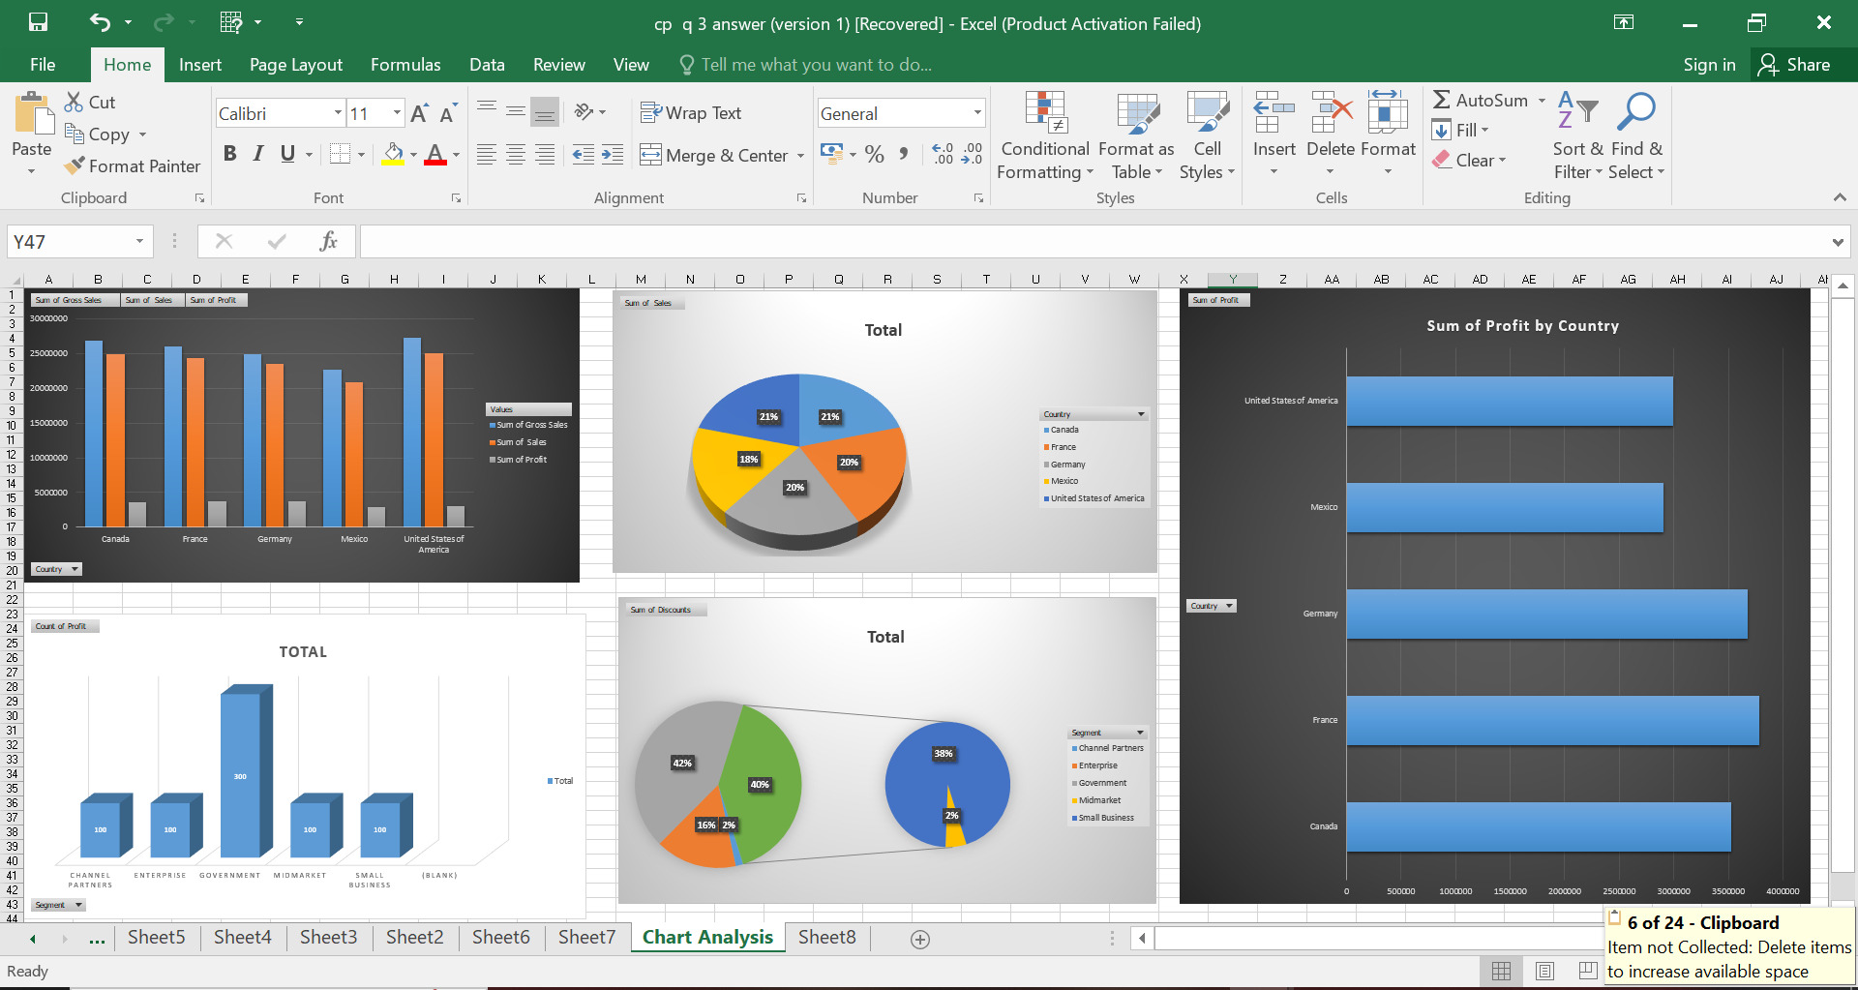

Slide 12
Quesstion 4: Insert the given data into the SQL server by making a Database and defining the required parameters for the construction of Database and Database tables.

Slide 13
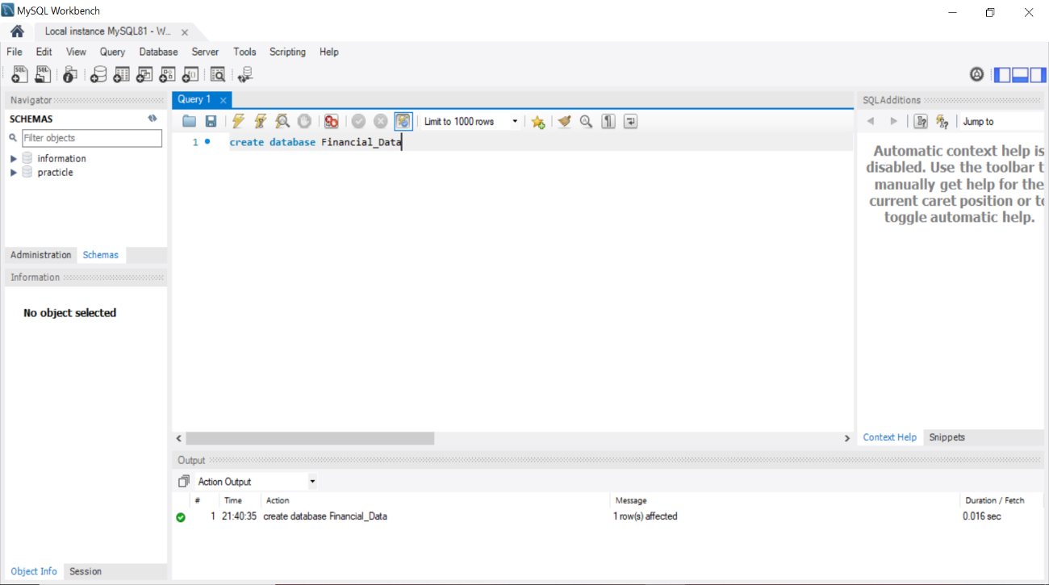

Slide 14
Question 5 : Verify if the data is properly imported into the SQL database(Try running few Queries)

Slide 15
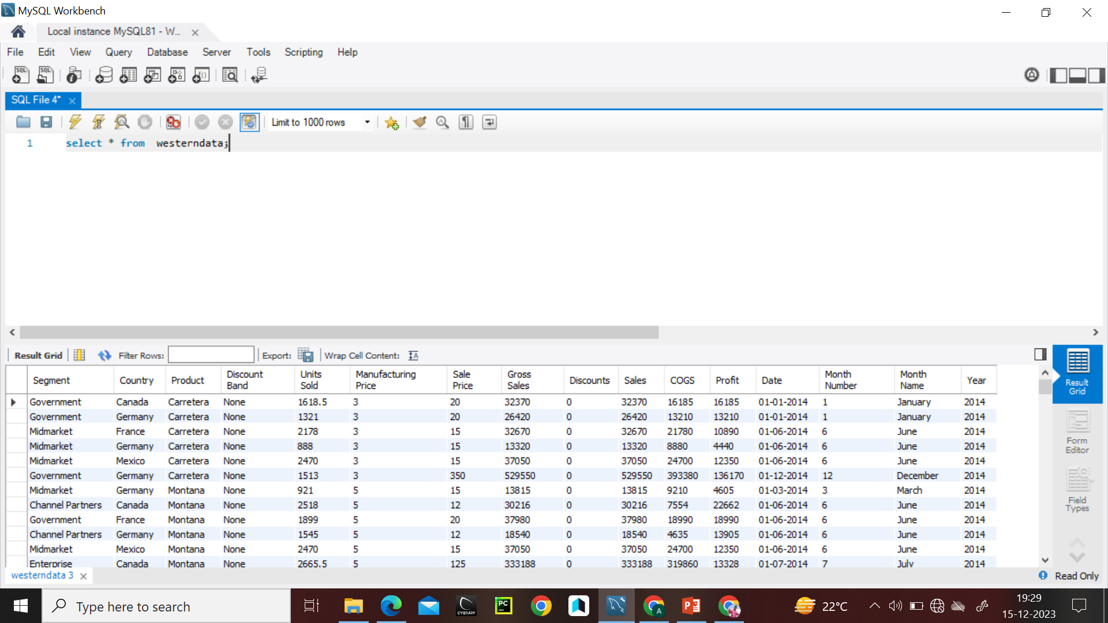

Slide 16
Question 6: Import the Data from the SQLDatabase into PowerBI ,verify if the data is properly imported or not.

Slide 17
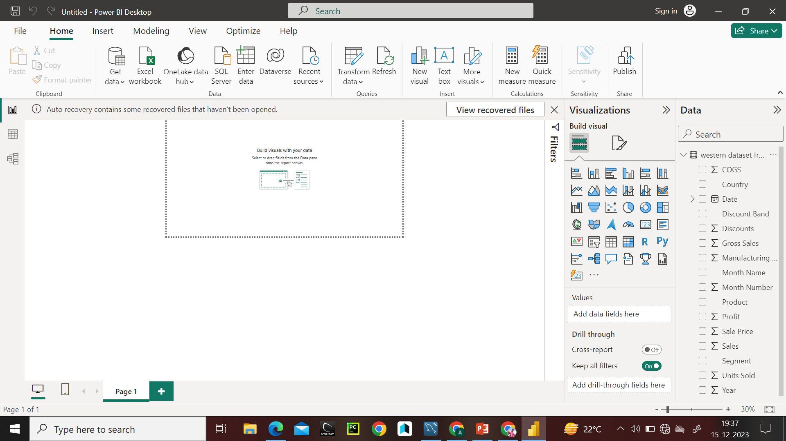
Data is imported in Power BI

Slide 18
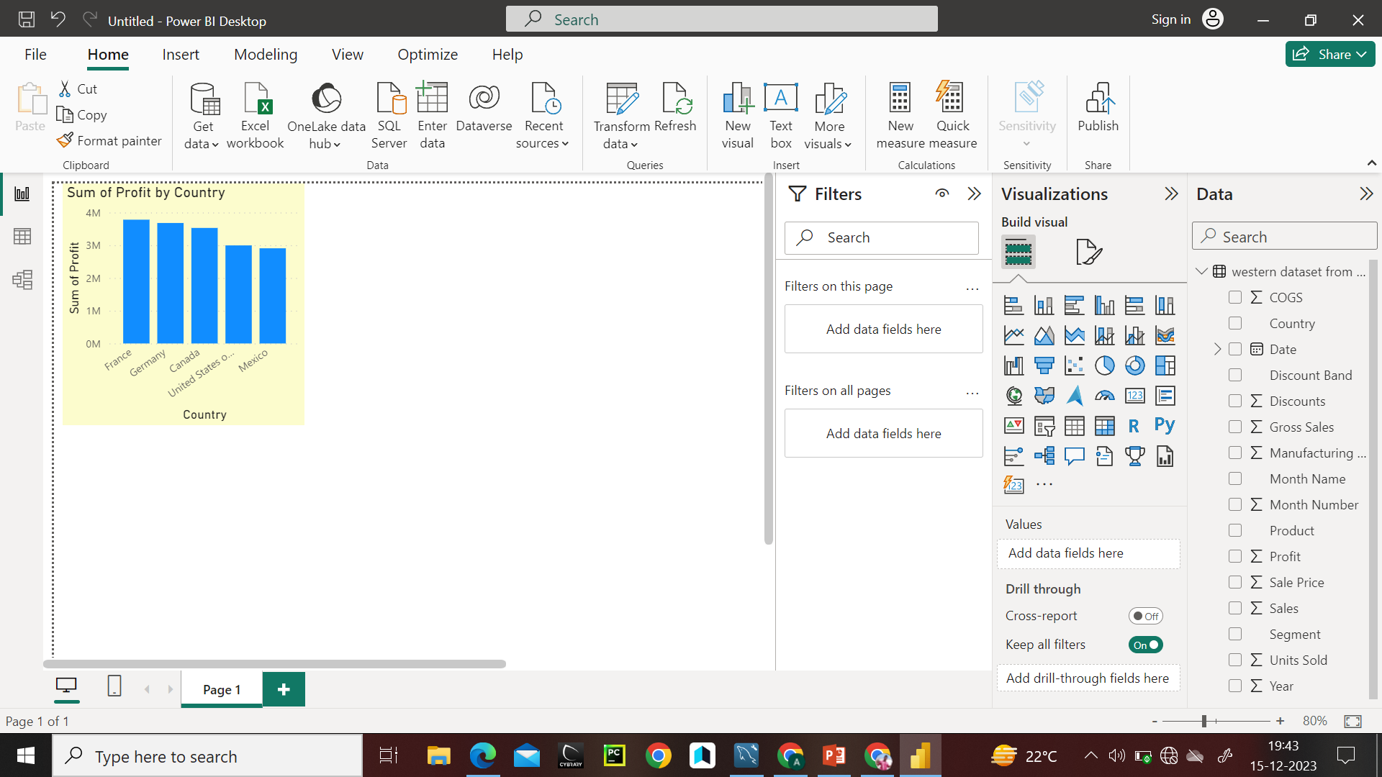
Let’s Try some data analysis on imported data for verify. Data is proper imported.

Slide 19
Question 7 : Perform Data cleaning and other possible operations on data using query editor ,create measures if necessary and use them to Visualize the data and make an interactive visualization.

Slide 20
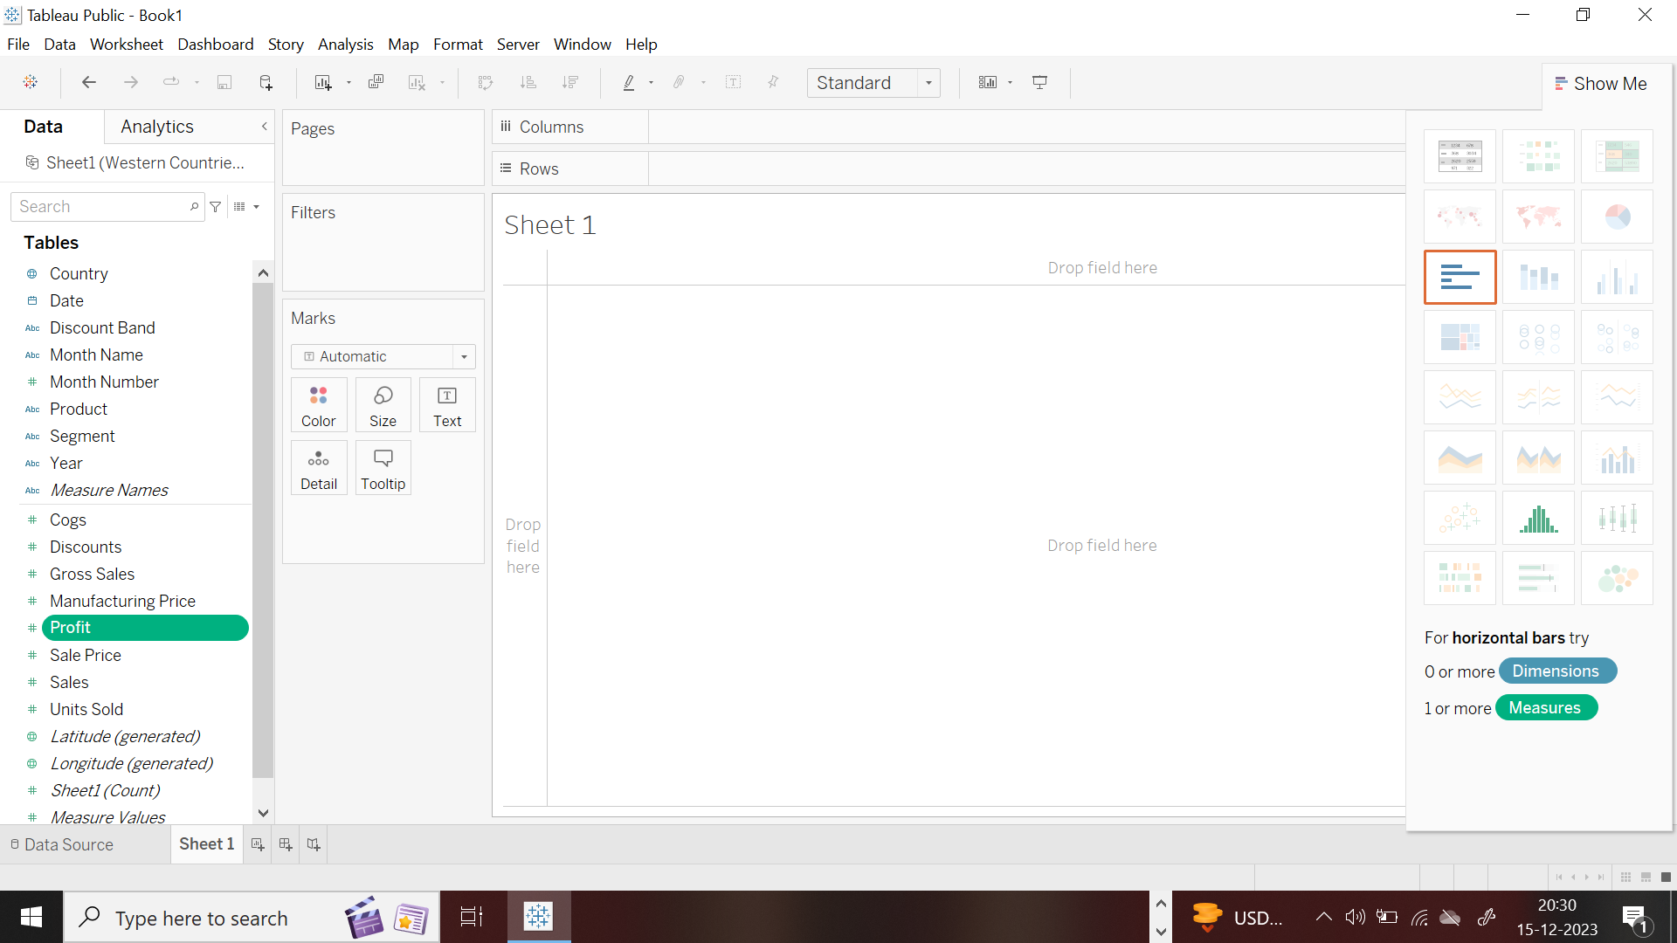
Here we can see dimension and measures.

Slide 21
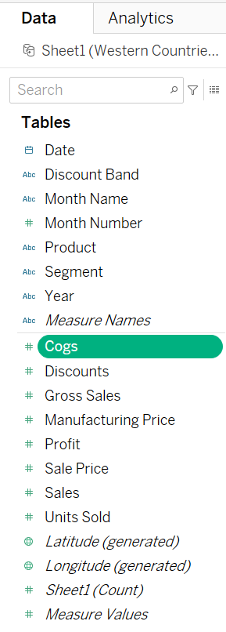
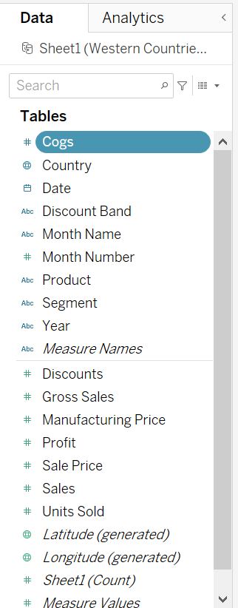
Here, we can change measures to dimension. Apply on cogs.

Slide 22
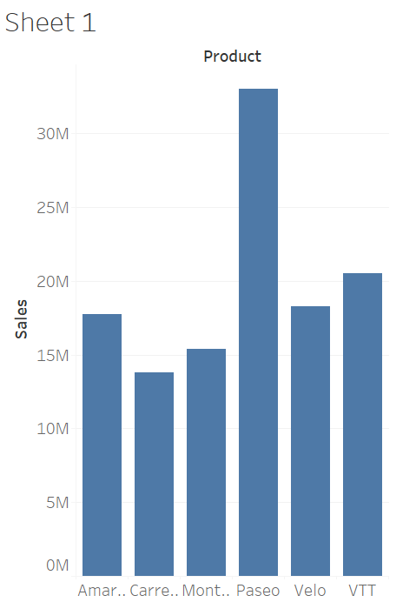
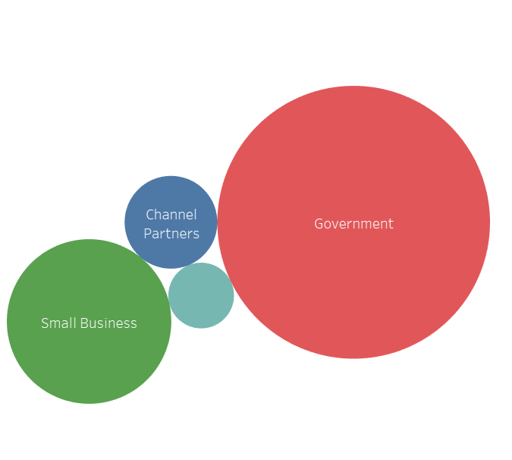
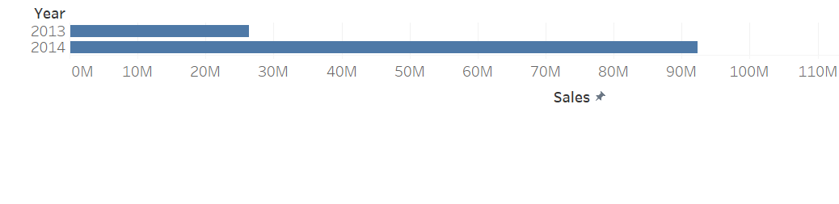

Slide 23
Question 8: Make a Detailed Interactive Dashboard by using visualization tools such as PowerBI and Answer the following questions
Product wise Sales
Segment wise Profit
Yearly sales
Country wise Sales
Profit and sales by Qtr
Yearly profit

Slide 24
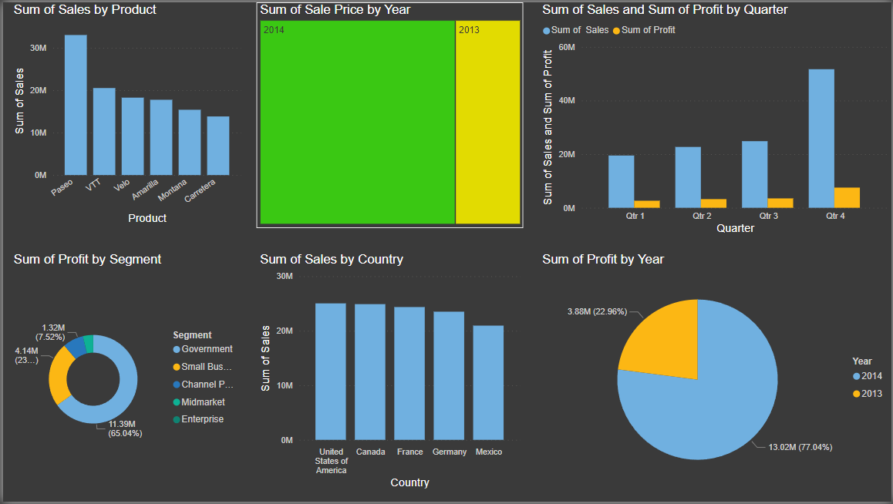

Slide 25
Top 2 countries
Bottom 3 products
Product wise discount
No. of units sold year over year
Segment wise Product Sales
Segment wise product wise profit

Slide 26
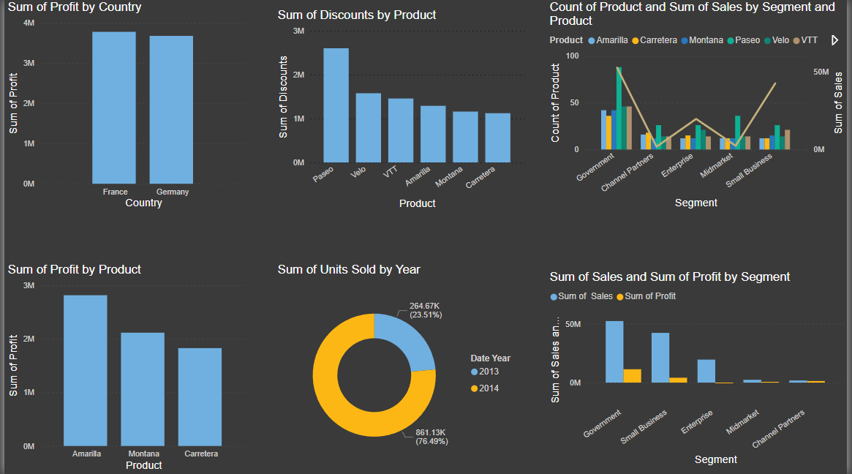

Slide 27
Question 9: Create a Visually pleasing Dashboard report by following the rules of making the Dashboard.

Slide 28
Question 10: Derive Conclusion and Inferences from the Dashboard.

Slide 29
Answer: We have a excusive data of sells of some product.
Here we can see.
After passing our data on the sales and product, we saw some things like cogs, gross sales and manufacturing cost. A thing which we found very easily, what happened behind it.
And by doing this visualization, solutions to even very difficult things are presented in a simple way. Visualization form is not a boring. it's looks like a simple neat and clean

